Slide 1

GCC Atar geography
Kimberly Wade-Wear #19956736

Slide 2
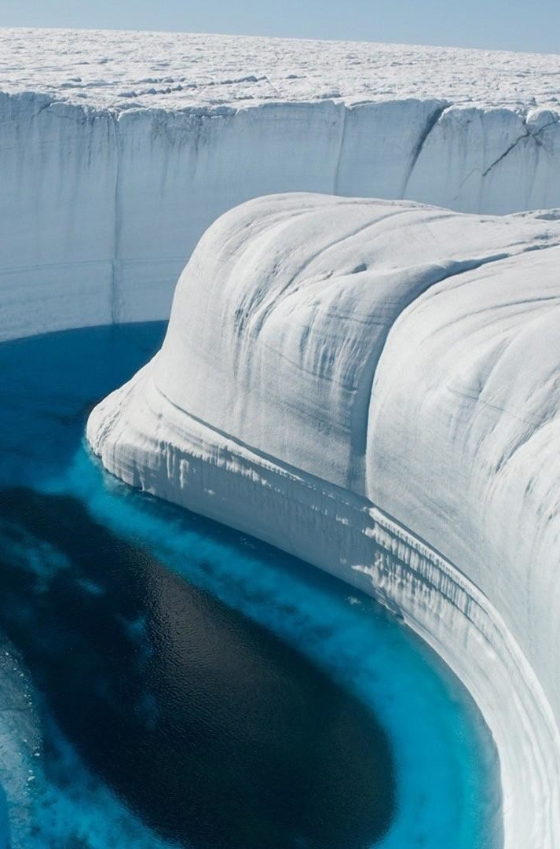
Syllabus Points
The spatial distribution of the world’s rainfall and temperature patterns
The key elements of the following natural systems: heat budget (including the greenhouse effect), hydrological cycle, carbon cycle and atmospheric circulation, and the ways in which they interact to influence the Earth’s climate

Slide 3
Spatial distribution (lapdog)
TEMPERATURE
Greater extremes in the Northern Hemisphere due to larger land masses.
Greater variations in land temperatures compared with the ocean.
Temperatures decrease with more proximity away from the Equator.
Seasonal temperatures fluctuate with humidity.
Coastal temperatures are more moderate than inland.
PRECIPITATION
Equatorial regions have the highest average precipitation due to the tropical climatic zone.
Deserts occur in the interiors of continents, in the latitudes of high-pressure systems.
Proximity to cool ocean currents leads to less precipitation.
Cold air masses over polar regions contain little to no rainfall.
When humid maritime meets cold air masses, precipitation forms.
Windward mountain slopes are locations for high precipitation, with leeward slopes producing less.

Slide 4
(lapdog) Latitude

Slide 5
(LAPDOG) Altitude
Temperature decreases 6.5 degrees Celsius every 1000m. At altitude there is more wind exposure affecting vegetation.
With increasing altitude, there is lower atmospheric density and a corresponding decrease in greenhouse gases density. Therefore, as there are less greenhouse gasses, there is less capacity to retain heat and so temperature decreases.

Slide 6
(LAPDOG) Prevailing Winds

Slide 7
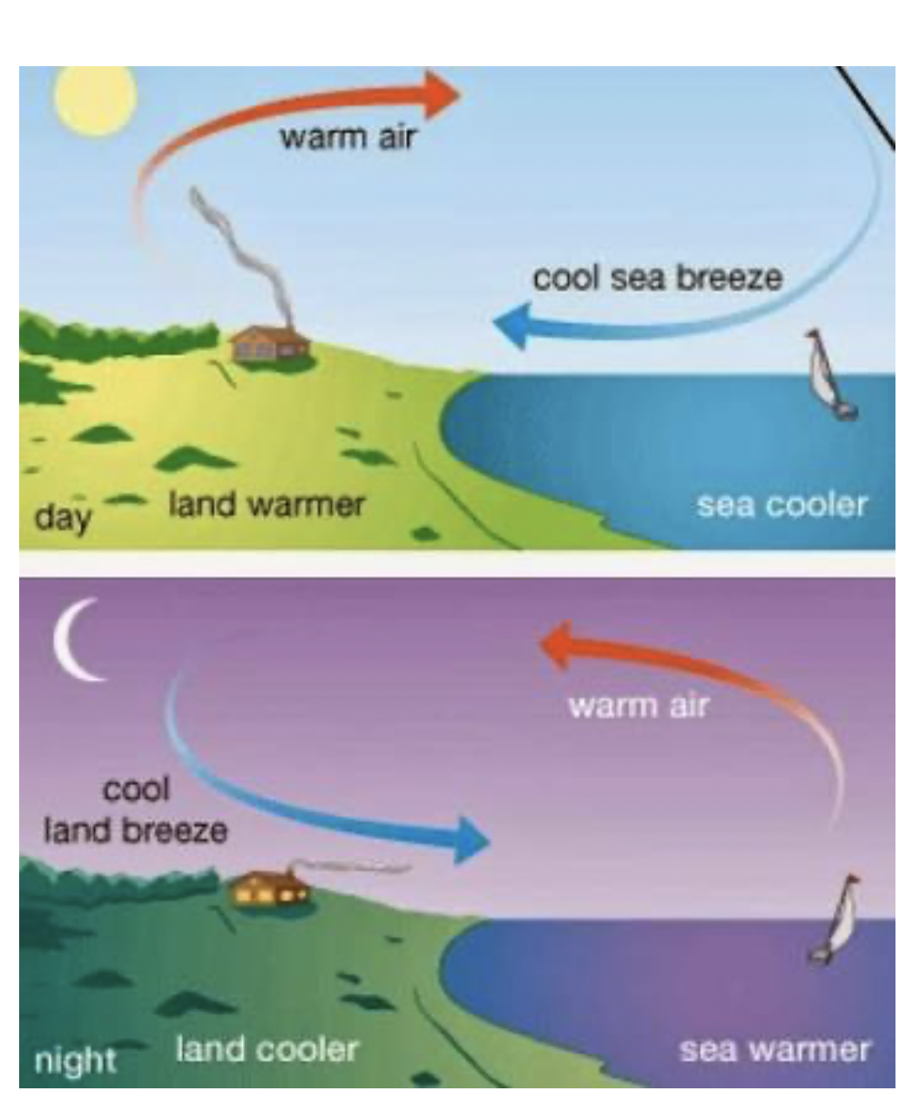
(Lapdog) dISTANCE FROM OCEAN
Temperature becomes more extreme with increasing distance from the ocean.
Land temperature changes faster than the oceans temperature. Therefore during the day, the ocean temperature is still cool from the night however the land temperature has warmed more. This means that the coastal temperature is moderate however further inland it is far warmer.
This is also the case for night. The ocean retains the heat of the day better than the land and hence at night the ocean changes temperature slower than the land and is still warm, compared to the land which is now colder and hence coastal area are a moderate temperature

Slide 8
(LAPDOG) Ocean Currents

Slide 9
(LAPDOG) Ocean Currents
Warm currents containing warm water which produces more water vapour due to more evaporation and therefore more moisture in the air leading to clouds absorption of moisture leading to rainfall.
The cold water in the cold currents does not evaporate as much and therefore little moisture in the clouds and hence little/no rain.

Slide 10
(LAPDOG) Great Mountain barriers

Slide 11
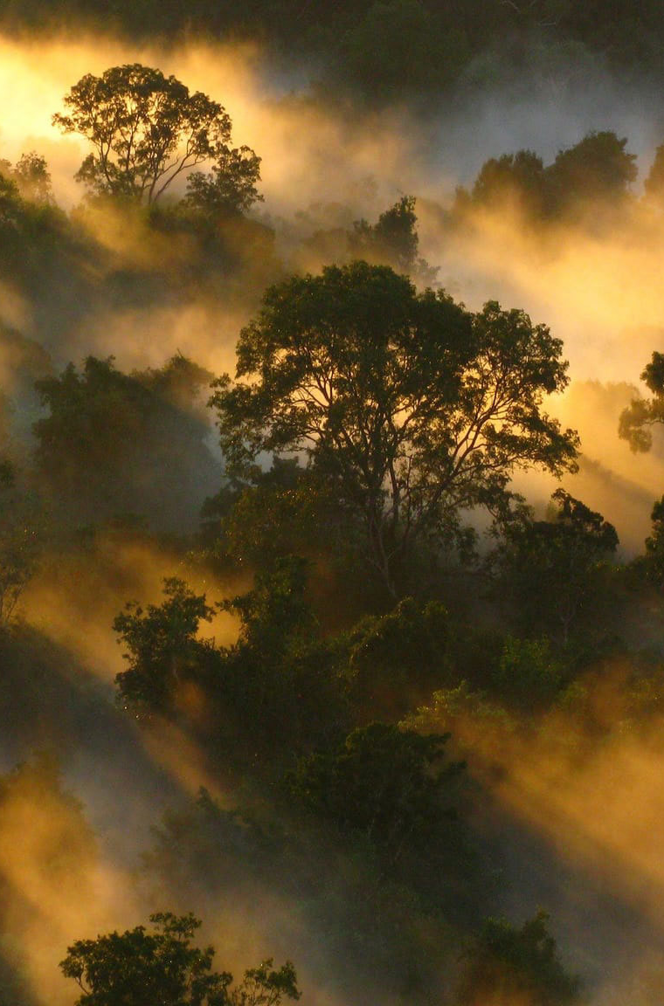
Natural Systems
Heat Budget
Greenhouse Effect
Water Cycle
Atmospheric Circulation
Carbon Cycle

Slide 12
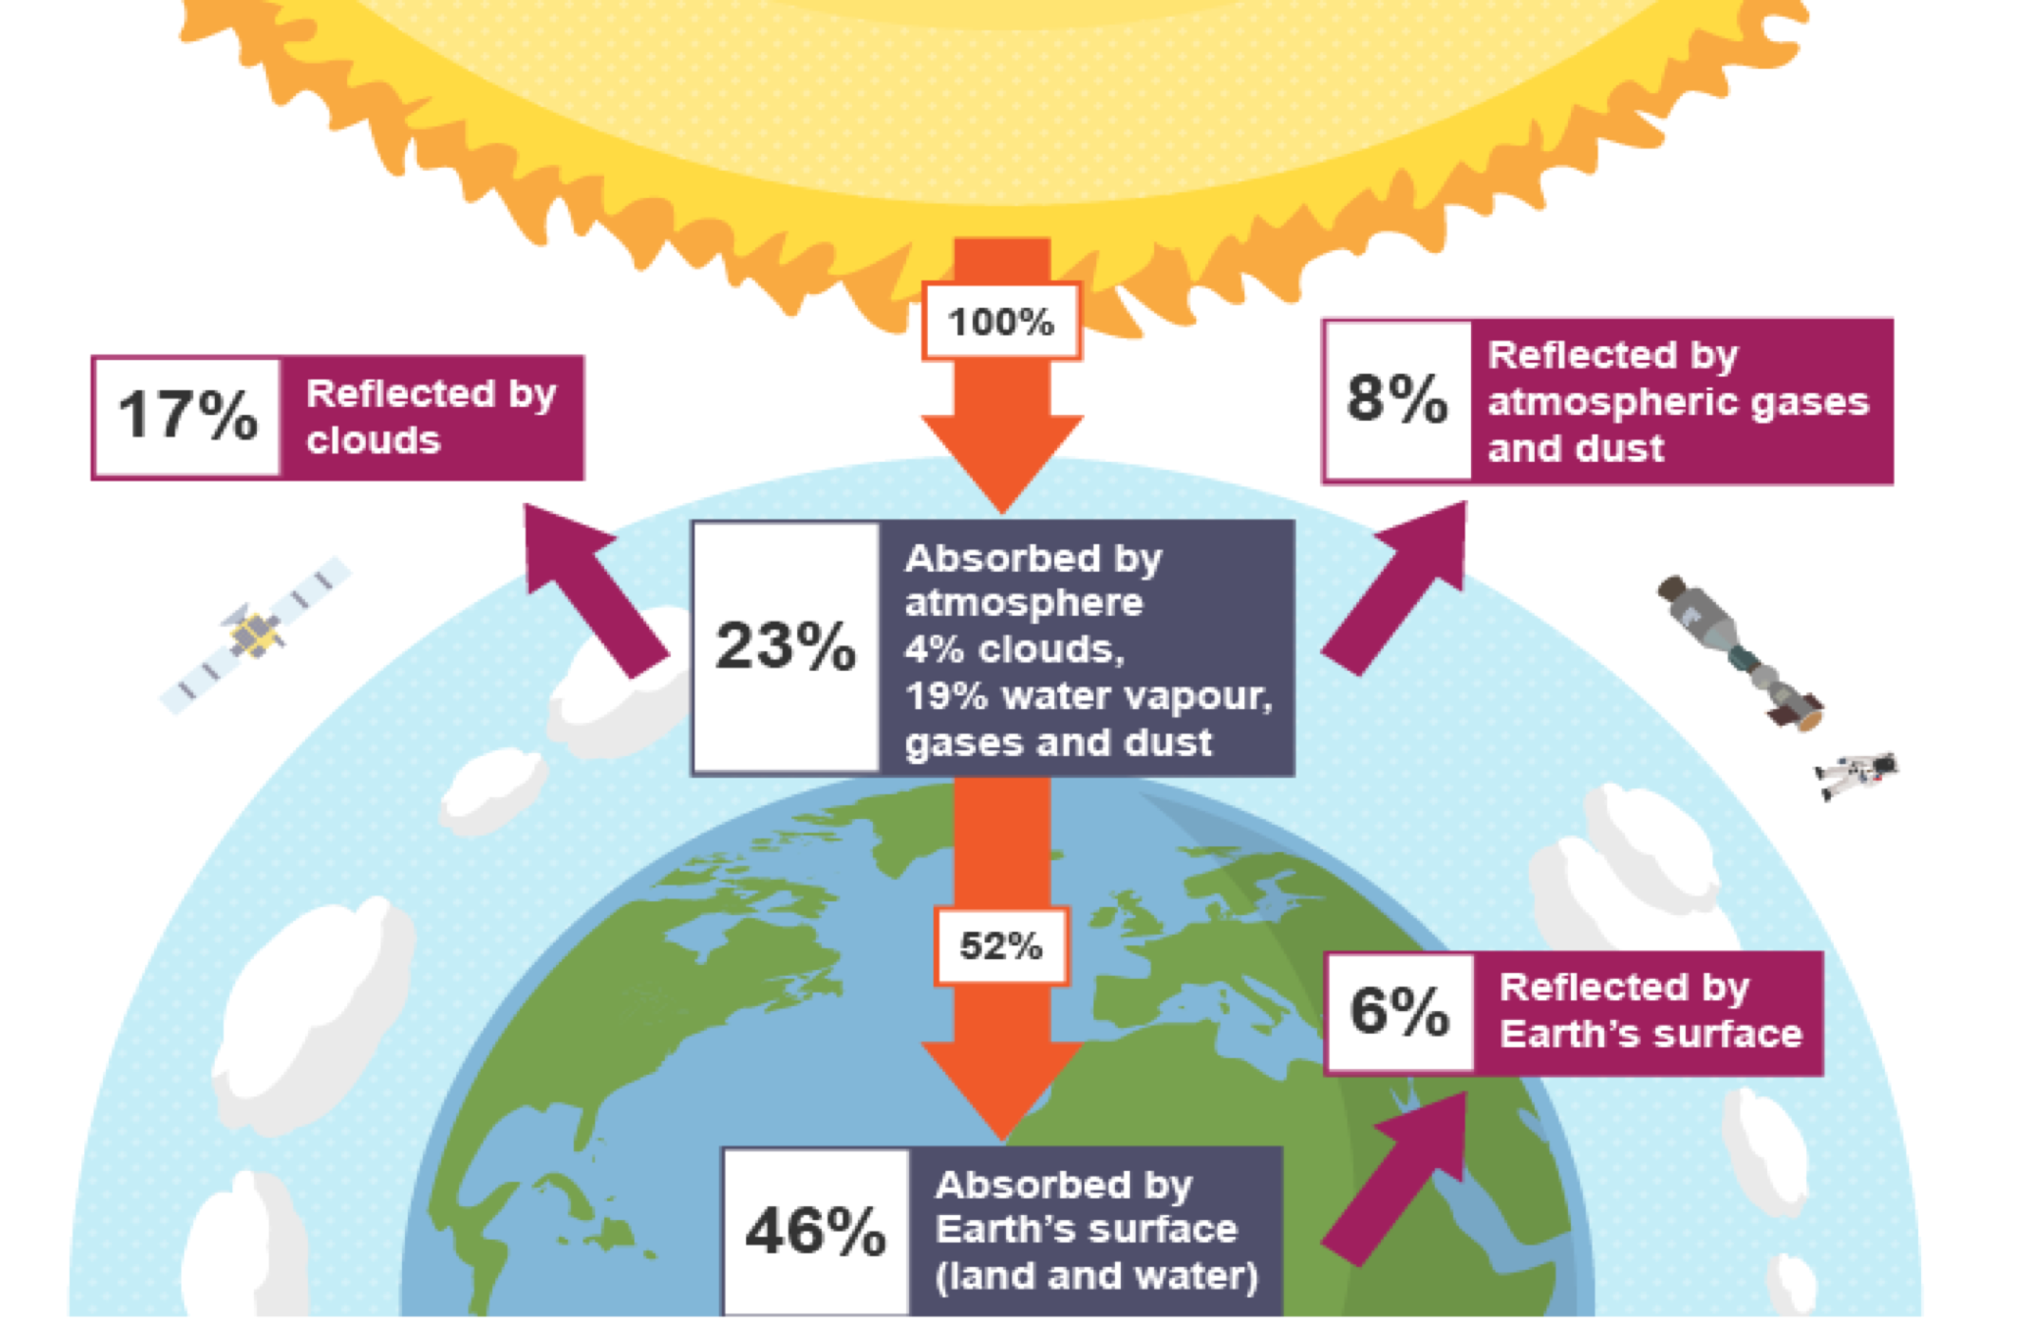
Heat Budget

Slide 13
Heat Budget Key Elements
Insolation: It takes heat eight minutes to travel to Earth, with orbital tilts producing small changes depending on season.
Atmospheric filtering: Light and heat is scattered and reflected by airborne particles.
Earth’s surface: Reflects and absorbs heat.
Greenhouse gases: Very effective in trapping heat (approximately 15% of incoming insolation).
Spatial variations through curvature of Earth’s surface, aspect, altitude, albedo and ocean currents.
Temporal variations through day and night, seasons, climate variability, El Ninó Southern Oscillation (ENSO) and climate change.

Slide 14
Water Cycle

Slide 15
Water Cycle Key Elements
Water reservoirs: 97% of all water is found in the oceans with 2% being found in ice caps and glaciers. The remaining 1% is distributed in rivers, lakes, soil, atmosphere and biosphere.
Evapotranspiration and condensation: Most of the water that enters the atmosphere as water vapour begins its journey in the tropics.
Advection and precipitation: Atmospheric air movements move the tropical water vapour towards the poles, producing alternating regions of low and high precipitation.
Infiltration and runoff: Water is returned to the seas or on to the land by precipitation. On the land it can infiltrate the soils and sometimes go deeper to become artesian water.
Spatial variations through Heat Budget, Atmospheric Circulation, landforms, land and sea proximity and soil.
Temporal variations through time of day, seasons, climate variability and climate change.

Slide 16
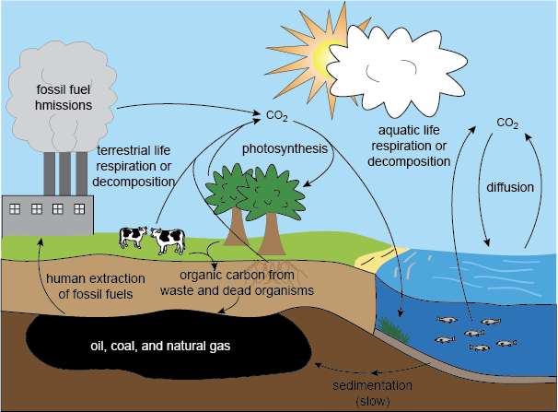
Carbon Cycle

Slide 17
Carbon cycle key elements
Atmosphere: Atmospheric carbon has increased over the last 200 years from about 280ppm to 380ppm.
Vegetation: Vegetation and phytoplankton are important in the removal of CO2 from the atmosphere.
Soil and fossils: Soils, rocks and fossil fuel deposits are major stores of carbon, some of which can be released into the atmosphere.
Oceans: The oceans act as a major carbon sink, especially when it is taken down into the deep ocean.
Anthropogenic carbon: Increasing amounts of carbon are being released into the atmosphere from human industrial, urban and rural activities.
Spatial variations through atmospheric carbon distribution, ocean and terrestrial distribution (e.g. sinks and stores).
Temporal variations through seasons and climate change.

Slide 18
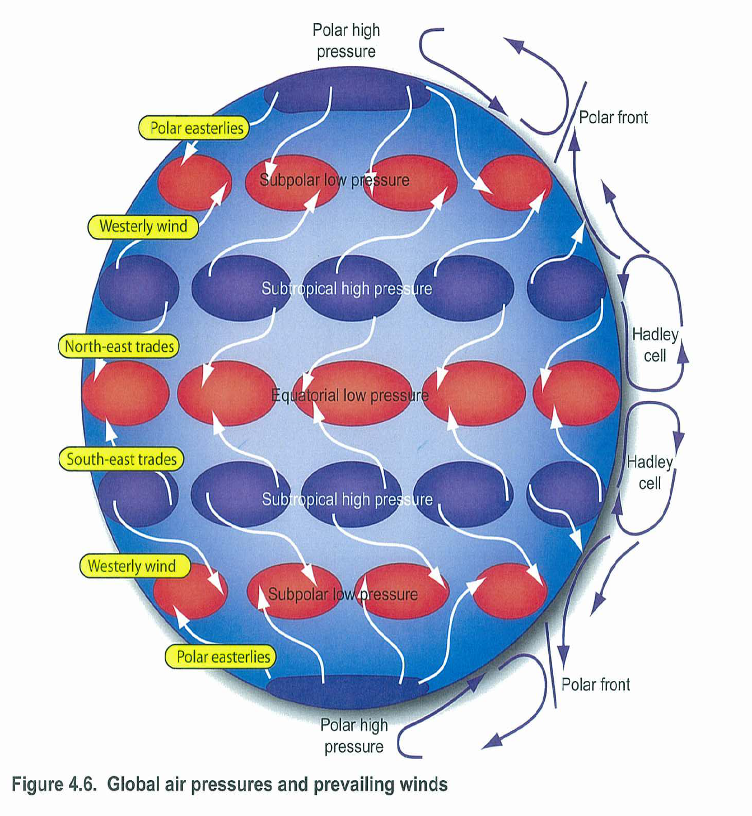
Atmospheric circulation

Slide 19
Atmospheric circulation key elements
Atmospheric circulation – is the large scale movement of air, and controls the distribution of thermal energy across the Earth (together with the much slower ocean circulation)
High and low pressure belts: Pressure belts form alternating bands of high and low pressure with winds blowing from high pressure to low pressure cells.
Prevailing winds: Winds moving away from high pressure systems blow towards adjacent low pressure cells. These prevailing wind systems are deflected to the right in the northern hemisphere and to the left in the southern by the rotation of the earth on its axis (when facing the Equator). This is called the Coriolis Effect.
Spatial Variations through altitude, latitude, and land and sea proximity.
Temporal Variations through day and night, season, climate variability and climate change (e.g. shifting climatic belts).

Slide 20
Interactions
Interactions
Heat Budget | Utilises the Carbon Cycle for storage of heat in the Greenhouse Effect. Utilises the Hydrological Cycle for transfer of heat in ocean currents and reflection off clouds. Utilises Atmospheric Circulation for transfer of heat in pressure systems.
Hydrological Cycle | Utilises the Heat Budget for processes of evaporation, condensation and precipitation. Utilises Atmospheric Circulation for advection currents and upward rain-bearing systems.
Carbon Cycle | Utilises Atmospheric Circulation for locations of the enhanced greenhouse effect. Utilises the Heat Budget for enhanced heating and cooling. Utilises the Hydrological Cycle for the transfer of CO2 from oceans.
Atmospheric Circulation | Utilises the Heat Budget for creation of high and low pressure systems and their intensity. Utilises the Hydrological Cycle for locations of high and low precipitation. Utilises the Carbon Cycle for the intensity and prevalence of rain, drought, storms, etc.

